Slide 1
Aurelian Manufacturing
Production as a Service — Autonomous, Data-Driven, and Scalable
CONFIDENTIAL
February 2026

Slide 2
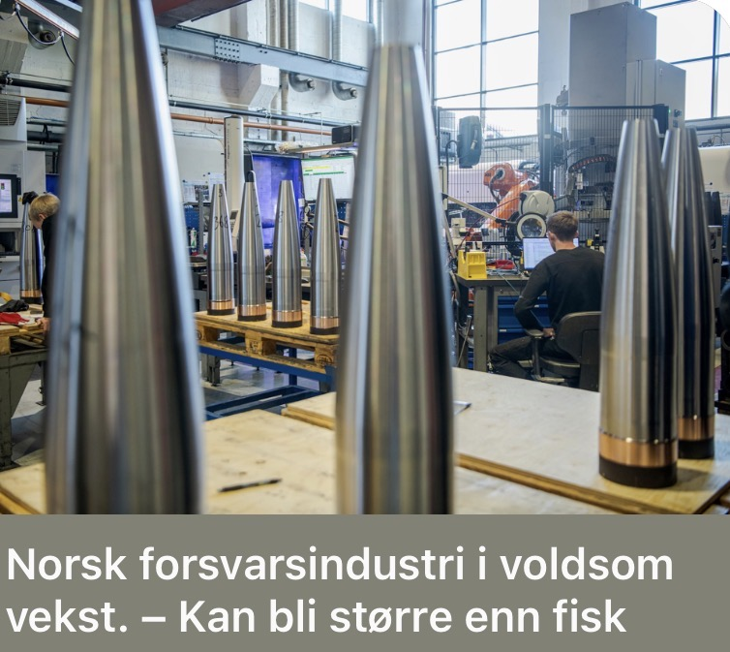
Investment Thesis — Market Outlook
Structural demand drivers spanning 2026 – 2035 and beyond
The Norwegian defense industry shows strong growth potential and could become larger than the seafood industry. (Aftenposten)
Defense
Path to 5% GDP
Energy & Renewable
Energy Transition &
Industrial Modernization
Langtidsplan i Norge 2025–2036 har en samlet ramme på ~NOK 1 624 mrd.
Investeringer ~NOK 135 mrd. per år, eller ~NOK 1 080 mrd. i perioden 2028–2035.
Oil / renewables / maritime: ~NOK 1,800–2,200 billion. Renewables / power: ~NOK 400–500 billion. Maritime / infrastructure: ~NOK 50–80 billion. Total: ~NOK 2,300–2,800 billion over the period
Energy transition and industrial modernization redefine manufacturing competitiveness around digitally integrated HMLV capacity.
The future of HMLV manufacturing is digital, automated and labor-agnostic.
Category Signal: Hadrian Automation
Founded Nov 2020, Latest round: ~$1.6B valuation, Led by T. Rowe Price and Andreessen Horowitz's a16z participated. Validates autonomous precision manufacturing for venture scale.

Slide 3
The Problem & Why Now
THE PROBLEM
Traditional HMLV Workshops Are Structurally Constrained
✗ Not designed for high machine utilization
✗ Automation without system architecture
✗ High dependency on individuals
✗ Brownfield constraints make 60–65% utilization structurally unrealistic
WHY NOW
✓ Defense & energy capex accelerating faster than supply
✓ Structural CNC capacity gap in Europe
✓ Autonomy + digital maturity now economically viable
✓ Greenfield advantage before legacy players adapt

Slide 4
The Solution — Greenfield Autonomous Platform
1
Greenfield Autonomous HMLV by Design
Aurelian scales with the combined value of skilled people and machines.
Lights-out operation, 24/7 unmanned, sub-linear staffing (16 staff for 20 CNC)
2
Digital-First Standardized Platform
SMART Factory automation, digital backbone, repeatable industrial platform
MAZAK iSMART Factory
Automation & IoT
3
Sub-Linear Scaling Economics
Break-even at 15-20% utilization, capacity grows faster than costs
4
Aligned Ecosystem from Machine to Customer
50/50 profit-sharing above 45% utilization, competitive pricing WITHOUT sharing

Slide 5
Why Aurelian Wins
✓ Utilization gap, not price, drives value
✓ Greenfield autonomy vs. legacy constraints
✓ Sub-linear cost structure
✓ Replicable industrial blueprint
Norwegian CNC Benchmark (Estimated Utilization)
Company | CNC Machines | Estimated Utilization
Rogaland Maskinering | 7 | ~10%
Lilaas | 15 | ~19%
Tamek | 8 | ~20%
Aarbakke | 55 | ~38%
Uvdal Maskinfabrikk | 11 | ~37%
Årdal Maskinering | 18 | ~47%
TP-Products (OEM) | 14 | ~40-45%
Aurelian Manufacturing | 20 | ~60-65% ✓
Source: Public financial data and industry benchmarks. Aurelian target reflects autonomous HMLV operations by design.

Slide 6

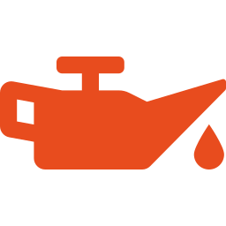



Go-to-Market Strategy
Forsvarsdrevet kommersiell oppramping med parallelle inntekter fra hurtigkonverterende segmenter
PARALELLE SPOR — RASK KONVERTERING
PRIORITY 1: DEFENSE & AEROSPACE
Energi, Olje & Gass
6–12 mnd syklus
NOK 1,624 Mrd
12–18 mnd
Equinor, Aker Solutions, TechnipFMC —Subsea connection systems -komponenter, vedlikeholdsdeler. ~NOK 2,300–2,800 mrd markedsvolum I segmentet
Norges forsvarsplan 2025–2036
Salgssyklus — starter mars 2026
Kongsberg Defence (KDA)
Missiler, fjernstyrte våpen — 10–30K CNC-timer/år
NAMMO
Ammunisjon/propulsjon — 5–15K CNC-timer/år
Saab Nordic / BAE Hägglunds / Andøya Space
Industriell Automasjon & Robotikk
3–6 mnd syklus
Physical Robotics — signert LOI. Europeisk robotmarked $5B → $37B innen 2033 (9.5% CAGR). Lavest risiko — allerede validert.
ISO 9001 → AS9100 → AQAP 2110 | Full digital sporbarhet
Generell Industri & Spot-ordrer
Fyller kapasitet mellom ankerordrer. Kort syklus, umiddelbar inntekt fra dag 1.
MAR 2026
Q3 2027
2028
2029+
GTM-launch & første kontakt
Første produksjon & FAI
35% utnyttelse — 8–13 kunder
50/50-modell & full skala

Slide 7
Economic engine — Capital efficiency
TARGET
Break-even at 15-20%
Steady state: 315M rev, 212.5M EBIT
60–65%
Year | CNC | Utilization | Revenue (MNOK) | EBIT (MNOK)
2028 | 8 | ~35% | 73 | 29
2029 | 11 | ~40% | 116 | 60
2030 | 14 | ~45% | 166 | 99
2031 | 20 | ~50% | 263 | 150
Sub-linear headcount growth: 6 staff → 10 staff → 13 staff → 16 staff
Note: Profit figures after 50/50 customer profit-sharing above 45% utilization

Slide 8
Path to Scale — Revenue, Profit & Headcount
Headcount Growth
År | CNC | Utnyttelse | Omsetning (MNOK) | Kostnader (MNOK) | Fortjeneste (MNOK) | Kommentar
2028 | 8 | 35% | 73 | 44 | 29 | Under terskel
2029 | 11 | 40% | 116 | 56 | 60 | Under terskel
2030 | 14 | 45% | 166 | 67 | 99 | Terskelnivå
2031 | 20 | 50% | 263 | 99 | 150 | Mutual value share
2032 | 20 | 55% | 289 | 108 | 160 | Mature, value share
2033 | 22 | 57.5% | 333 | 116 | 190 | Strong, value share
2034 | 24 | 60% | 378 | 124 | 220 | Sweet Spot, value share
2035 | 25 | 65% | 427 | 133 | 245 | Extreme, value share
Traditional: 2.5 people per CNC
Aurelian: 0.8 people per CNC
3x labor efficiency
Industry benchmark: 50 staff for 20 CNC (0.4 CNC/person)
Aurelian 2035: 20 staff for 25 CNC (1.25 CNC/person)

Slide 9
Financing Structure & Investor ROI
Round | Ask (MNOK) | Pre-Money | Dilution | Purpose
Pre-Seed | 5 | 25 | 16.7% | Runway, agreements, IP
Seed | 47 | 140 | 25.1% | Workshop + 8 CNC + buffer
Series A | 42 | 250 | 14.4% | Scale to 20 CNC
Investor Returns vs. Market Expectations
Round | Market Expected ROI | Aurelian Projected ROI | Status
Pre-Seed | 20-40x | ~49x | ✓ Above market
Seed | 10-25x | ~10.5x | ✓ Within range
Series A | 5-10x | ~8x | ✓ Strong
Founders retain 53.4% post-Series A
Exit Scenario: 2.3 Billion NOK valuation (10x EBITDA multiple on 222 MNOK)

Slide 10
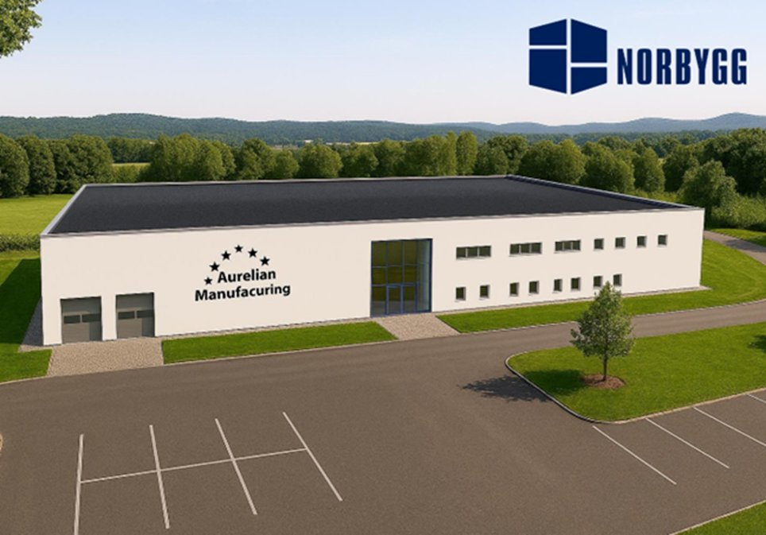
European Scaling Blueprint
Replicable Industrial Platform
Site-Zero as Blueprint
Standardized Platform
Validates operating model, acts as reference facility
Same CNC, automation, digital backbone for all sites
Greenfield, Autonomous
Demand-Anchored
Each site built for lights-out from day one
New sites driven by strategic customer demand
Potential expansion: Norway, Nordic and Europe — aligned with defense & industrial value chains

Slide 11
Team & Advisors
André Tandberg
Tore Ausland
Henrik Strøm
Co-Founder & CEO
Co-Founder & VP BD
Board Member
MD Østfold Follo Nyskapingsfond, Board SpareBank 1 Østfold Akershus. Industrial funding + manufacturing ecosystem
30+ years oil & gas (GE, FMC, Aker). Enterprise partnerships, anchor customer acquisition
Banking & finance (Trøgstad Sparebank). Financial structure, reporting, bank dialogue
ADVISORY BOARD
Fredrik Vangsal
Bjørnar Torsnes
Andreas Mollatt
Tech & Automation: CEO Disruptive Engineering, automation architecture
Industry & Scaling: Chairman CodeIT (VW, TINE, Mowi clients), enterprise sales
Capital & Scaleups: Physical Robotics CBO, fundraising expertise (Otivio)

Slide 12
Traction & Execution Readiness
VALIDATED PROGRESS
TIMELINE & FACILITY
✓ Customers in pipeline
✓ Mazak partnership secured
✓ Workshop location: Våler, 30,000 m² site
✓ Norbygg developer partnership
✓ Proof-of-concept validated
✓ Shop layout defined
12 MONTHS
From investment to production
First production: Q3 2027
• 2,635 m² first phase
• Scalable to 20-25 CNC machines
• Multi-modal logistics (rail, sea, road, air)
• Strategic location: Våler, Østfold

Slide 13
The Ask
Raising: Seed Round — 47 MNOK
USE OF FUNDS
YOU GET
• 8 CNC machines, automation and base setup(40 MNOK equity)
• Operating buffer (7 MNOK)
• 50% equity requirement on equipment
• 25.1% dilution (industry standard)
• Expected 10.5x ROI at exit
• Exit: 2.3B NOK valuation (2035)
• De-risked by customer anchors
Contact: André Tandberg, CEO
andre@aurelian.no

